Slide 1
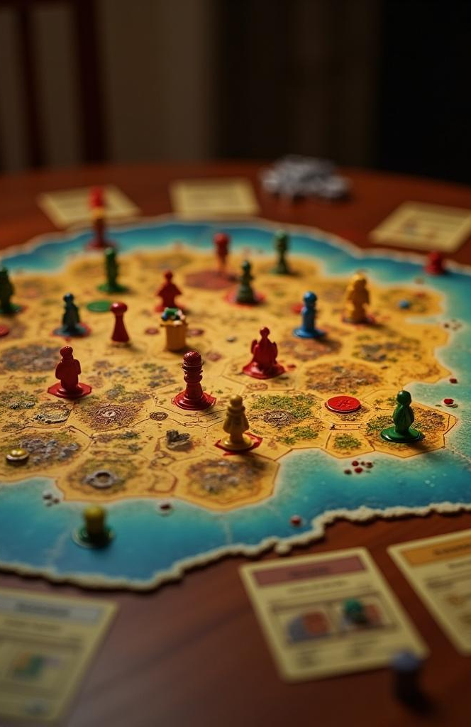
The Java Catan Project
An overview of the implementation of the Catan board game in Java using OOP principles.
Introduction to Object-Oriented Programming CS120
Sergey Martirosyan Armen Simonyan Tigran Hovhannisyan

Slide 2
Introduction
This presentation delves into the architecture and design choices made in developing a Java version of the popular board game Catan, highlighting the object-oriented programming (OOP) principles applied throughout the project.

Slide 3
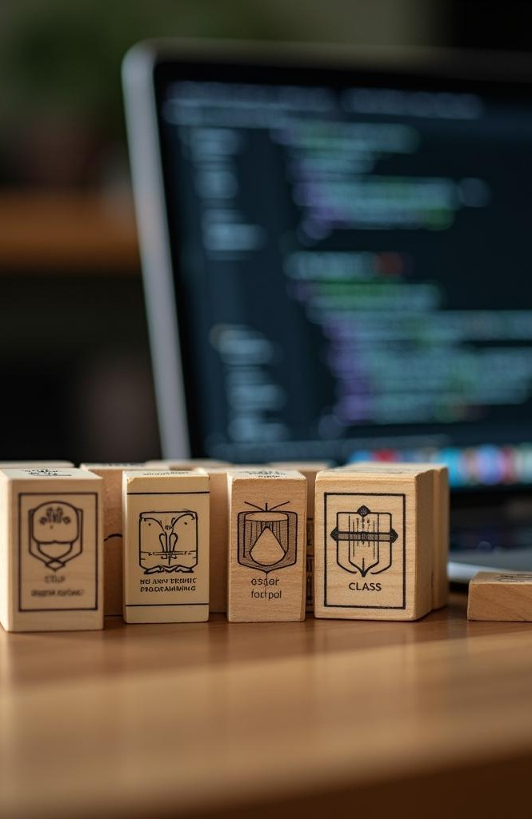
01
Classes

Slide 4
Game Elements
The core of the Catan game is represented through various classes, each encapsulating different game elements such as the Board, the Tiles, and the Development Cards. Each class is responsible for managing its state and behavior, providing a clear separation of concerns which enhances maintainability.

Slide 5
Player Management
Player interactions are handled by a dedicated Player class. This class manages player resources, actions, and status. It provides methods for resource trading, building structures, and tracking victory points, ensuring that each player's state is accurately represented during the game.

Slide 6
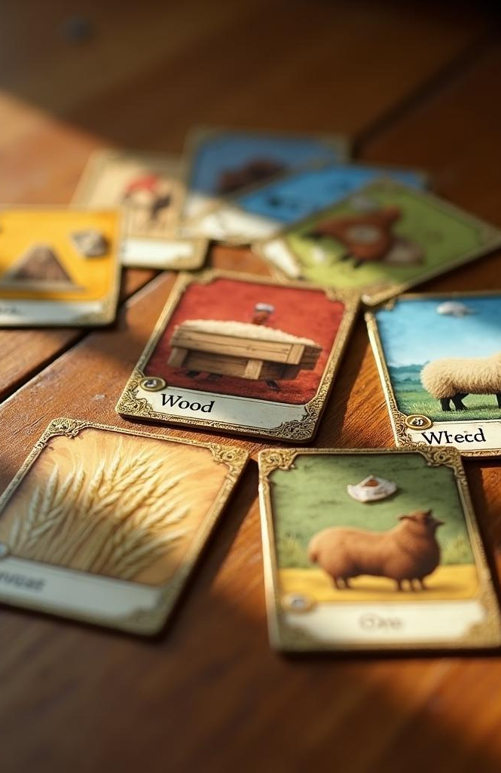
Resource Handling
Resource handling is a fundamental aspect of the Catan game, represented through a dedicated Resource class. This class models different types of resources such as wood, brick, sheep, wheat, and ore. It provides functionality for resource allocation, trading, and updating player inventories, ensuring a dynamic gameplay experience. Efficient management of resources is essential for strategic planning and decision-making within the game.

Slide 7
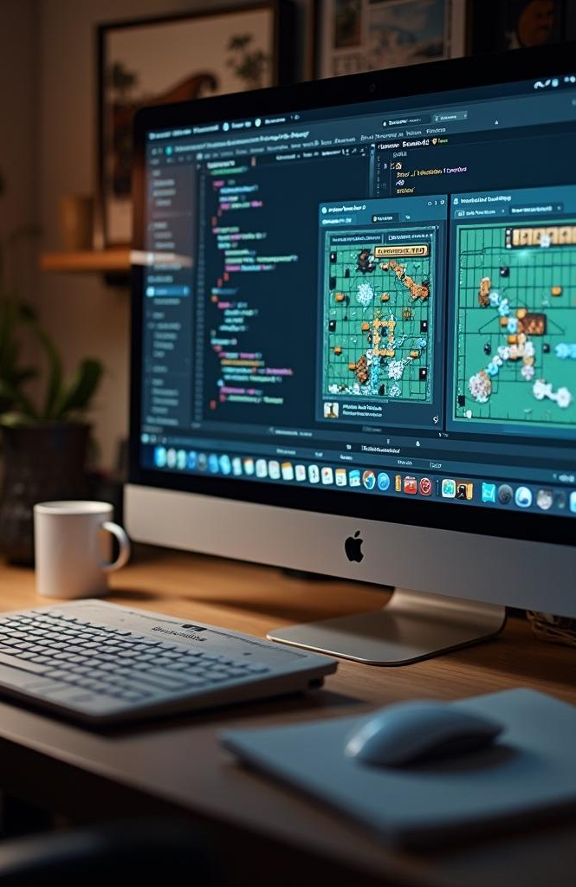
02
UI Solution

Slide 8
Design Overview
The user interface for the Java Catan project is designed to be intuitive and engaging. Utilizing Java Swing or JavaFX, the UI emphasizes clear visualization of the game board, player resources, and available actions. The design is user-centric, aiming to minimize learning curves and promote ease of use for players of all ages.

Slide 9
User Interaction
User interaction is facilitated through a variety of UI components, including buttons, sliders, and modal dialogs. These components allow players to perform actions such as rolling dice, trading resources, and building roads or settlements with minimal friction. Clear feedback mechanisms are integrated to confirm user actions and enhance the overall experience.

Slide 10

Technical Implementation
The technical implementation of the UI is grounded in MVC architecture, separating the model, view, and controller layers. This structure ensures that the game logic is independent of the UI, allowing for easier updates and modifications. Event-driven programming is utilized to respond quickly to user inputs and update the interface dynamically, ensuring a smooth gameplay experience.

Slide 11
Conclusions
The Java version of Catan showcases the effective application of OOP principles and a thoughtful UI design. The project's structure promotes maintainability and scalability, allowing for future enhancements and adaptations. This presentation highlights the integral components that contribute to the overall user experience, emphasizing the successful integration of game mechanics with an intuitive interface.

Slide 12
Thank you!
Do you have any questions?

